Slide 1
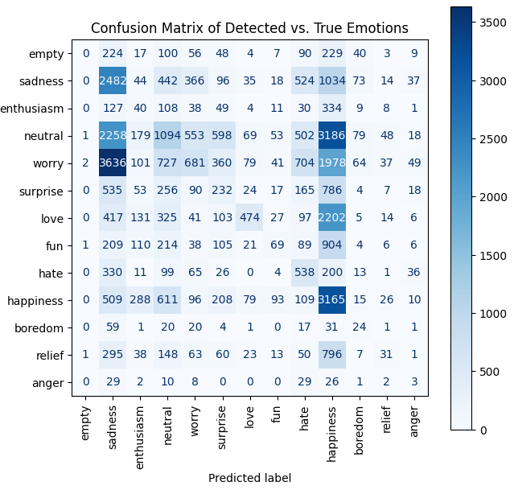
Llama 1B parameters, return string
Failed to detect emotion in 3854 sentences
Setting to neutral
Balanced Accuracy: 0.1696
Accuracy: 0.2208

Slide 2
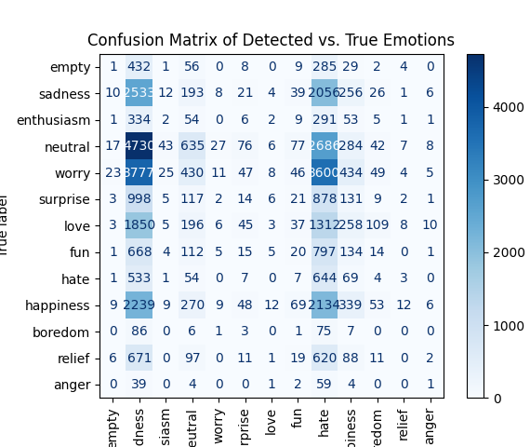
Llama 1B parameters, return number
Failed to detect emotion in 1493 sentences
Setting to neutral
Balanced Accuracy: 0.0883
Accuracy: 0.1051

Slide 3
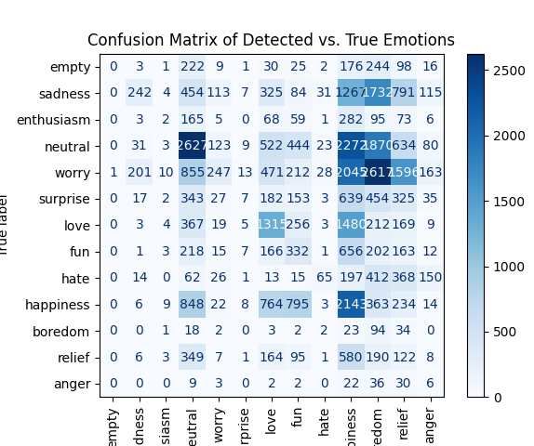
Llama 3B parameters (Q4), return number
Failed to detect emotion in 2 sentences
Setting to neutral
Balanced Accuracy: 0.1566
Accuracy: 0.1800

Slide 4
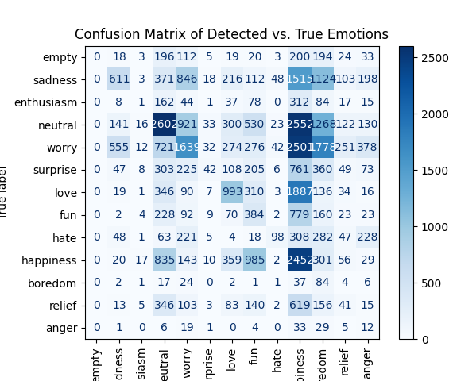
Llama 3B parameters (Q8), return number
Failed to detect emotion in 4 sentences
Setting to neutral
Balanced Accuracy: 0.1737
Accuracy: 0.2240

Slide 5
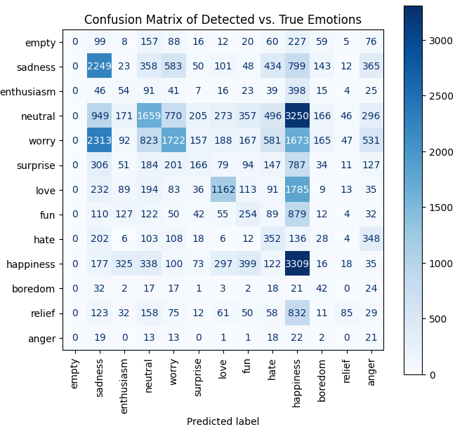
Llama 8B parameters, return string
Failed to detect emotion in 1609 sentences
Setting to neutral
Balanced Accuracy: 0.2159
Accuracy: 0.2769

Slide 6
Llama 8B parameters, return number
Failed to detect emotion in x sentences
Setting to neutral
Balanced Accuracy: 0.yyyy
Accuracy: 0.zzzz

Slide 7
Prompts
Reason
Return the most evident emotion in the given sentences. Reply only with one emotion from this list: sadness, enthusiasm, neutral, worry, surprise, love, fun, hate, happiness, boredom, relief, and anger.
Text
Detect the most prominent emotion in the sentence I will give you, by selecting the emotion from the following list: sadness, enthusiasm, neutral, worry, surprise, love, fun, hate, happiness, boredom, relief, anger
Number
Detect the most prominent emotion expressed in the text I will give you. Use only a number from the list 1, 2, 3, 4, 5, 6, 7, 8, 9, 10, 11, and 12 in your response to represent the detected emotion, where the returned numbers correspond to detected emotions using the following mapping: 1. sadness 2. enthusiasm 3. neutral 4. worry 5. surprise 6. love 7. fun 8. hate 9.happiness 10. boredom 11. relief 12. anger
Include your reason for selecting this emotion.
Structure the returned list as JSON using: [{"emotion": "detected emotion", "rationale": "your explanation"]}, ...]
Your reply must be just one word selected from the above list. Do not use anything else!
Do not use any words in your response, just the number corresponding to the most prominent emotion

Slide 8
Comparison
Model | Prompt | Phrases not detected | Accuracy | Balanced accuracy
1B@Q8 | Reason | 3854 | 0.2208 | 0.1696
1B@Q8 | Text | 195 | 0.2158 | 0.0772
1B@Q8 | Number | 1502 | 0.1050 | 0.0882
3B@Q4 | Number | 4 | 0.1800 | 0.1566
3B@Q8 | Text | 4563 | 0.2354 | 0.1734
3B@Q8 | Number | 1 | 0.2240 | 0.1737
8B@Q4 | Reason | 1609 | 0.2769 | 0.2159
8B@Q4 | Text
8B@Q4 | Number | 307 | 0.2449 | 0.1750

